Slide 1

H2O Debug Tool
Insyde Software March, 2021

Slide 2
Agenda
H2OFFT
H2OSDE
H2ORTE
H2OUVE
H2ODST

Slide 3
H2OFFT (Firmware Flash Tool)

Slide 4
Features
Function
Save and make a backup file of the current system BIOS before updating with a new one.
Easily update the system BIOS under supported OS environment.
Verify the system BIOS to ensure system reliability.
Auto detects hardware settings so user will know if H2OFFT is compatible with system or not. This gives enhanced security.
Supported OS environment
UEFI SHELL
DOS
WINDOWS
LINUX

Slide 5
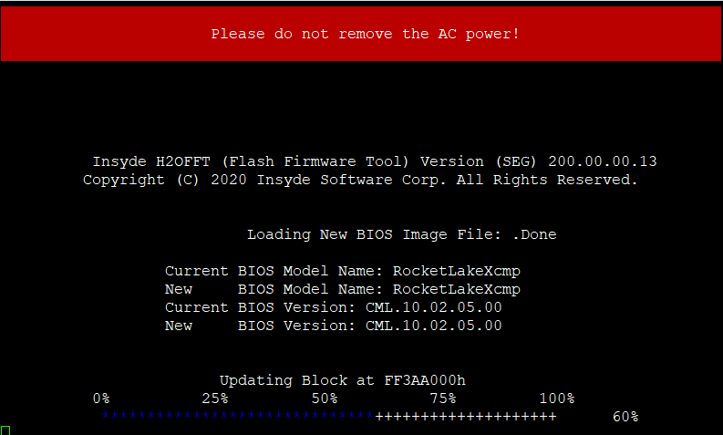
Screenshot of Execution

Slide 6
H2OSDE (SMBIOS Data Editor)

Slide 7
Features
To provide 3 kinds of UEFI DMI Editors
DMI Editor: To edit “runtime/current DMI setting” of platform
File DMI Editor: To edit “DMI data” in DMI file
Image DMI Editor: To edit “DMI Default Setting” of BIOS image
Supported OS environment
UEFI SHELL
DOS
WINDOWS
LINUX

Slide 8
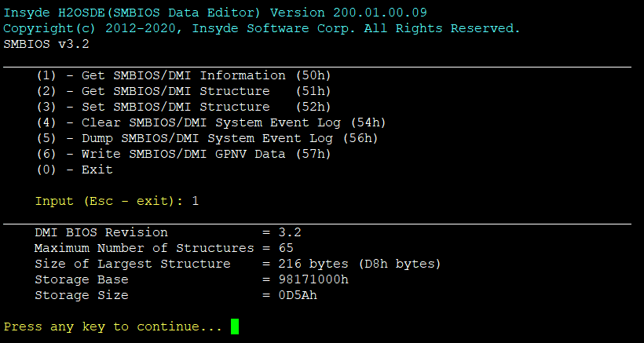
Screenshot of Execution

Slide 9
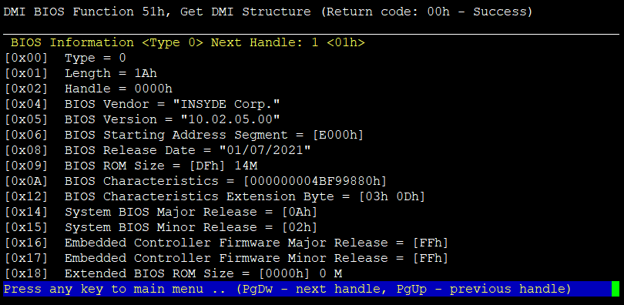
Screenshot of Execution

Slide 10
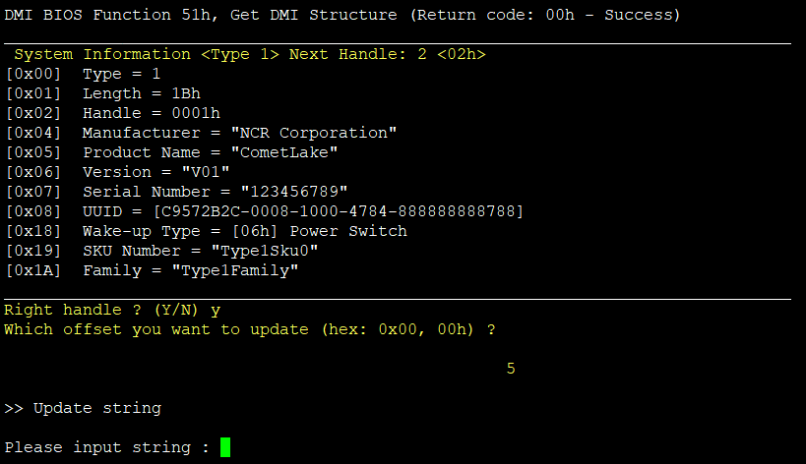
Screenshot of Execution

Slide 11
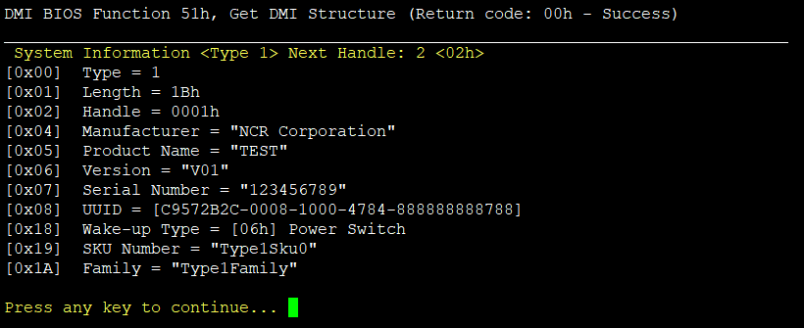
Screenshot of Execution

Slide 12
H2ORTE (Register and Table Editor)

Slide 13
Features
Engineering debugging and performance analyze tool
Provide save / load / compare function
Operate the configuration of the platform
Read / Write the system data of platform
Send reset / shutdown command to system
Supported OS environment
UEFI SHELL
DOS
WINDOWS
LINUX

Slide 14
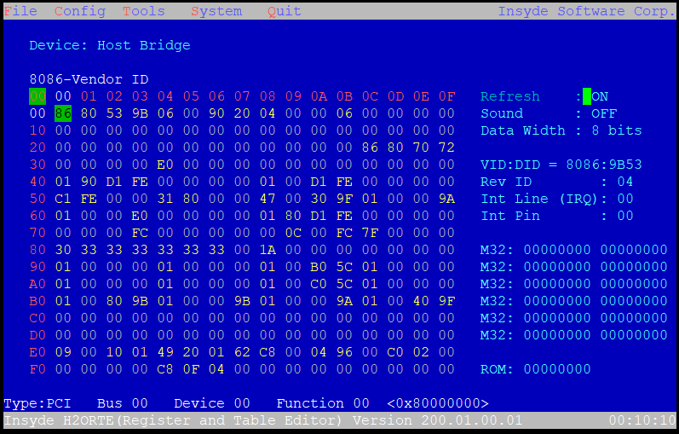
Screenshot of Execution - Main

Slide 15
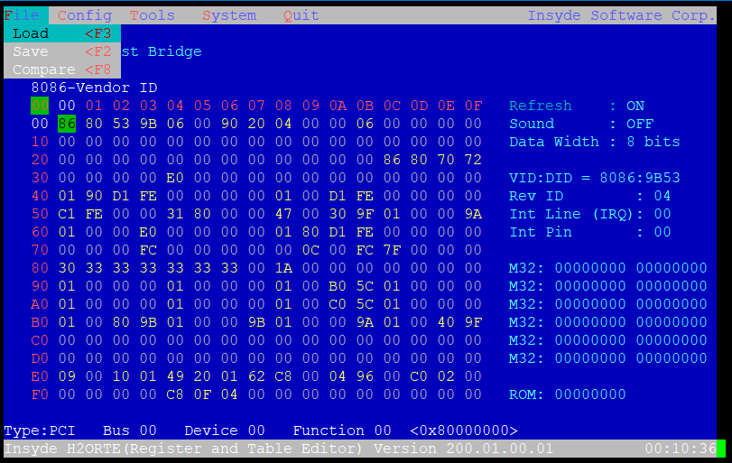
Screenshot of Execution - File

Slide 16
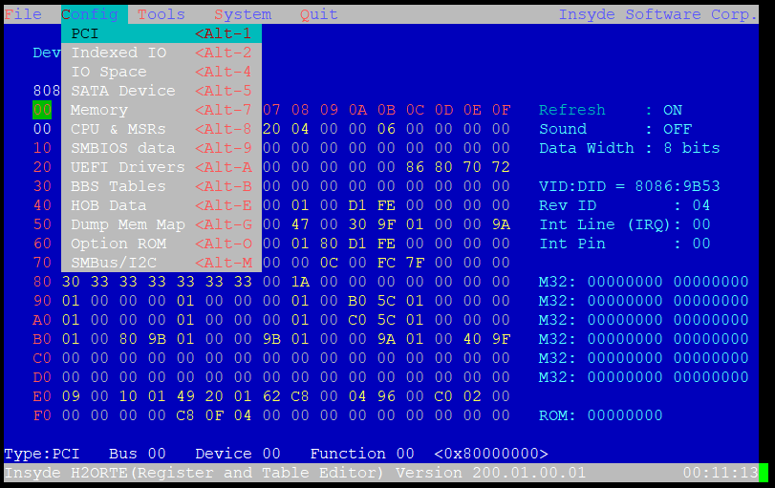
Screenshot of Execution - Config

Slide 17
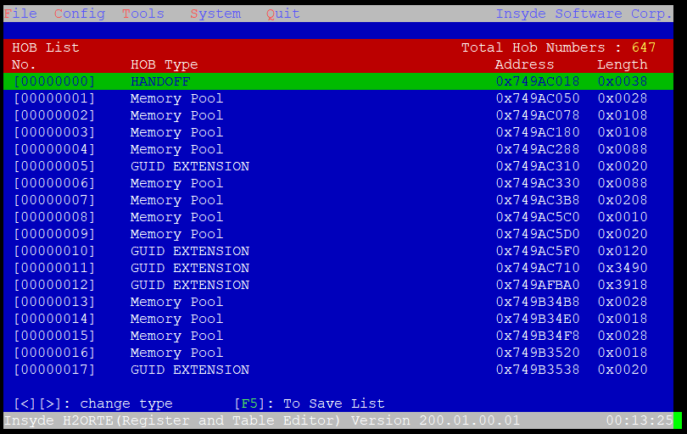
Screenshot of Execution – Config - HOB

Slide 18
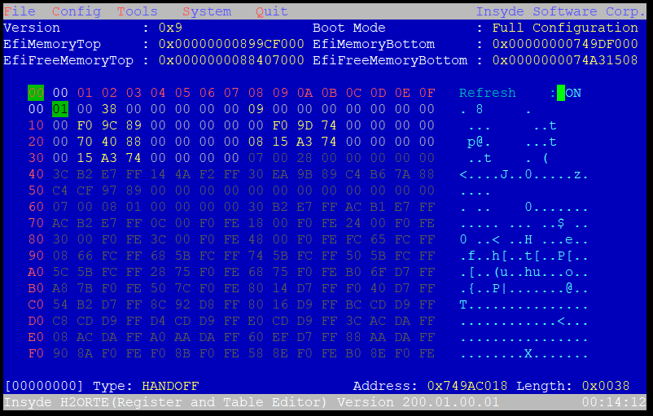
Screenshot of Execution – Config - HOB

Slide 19
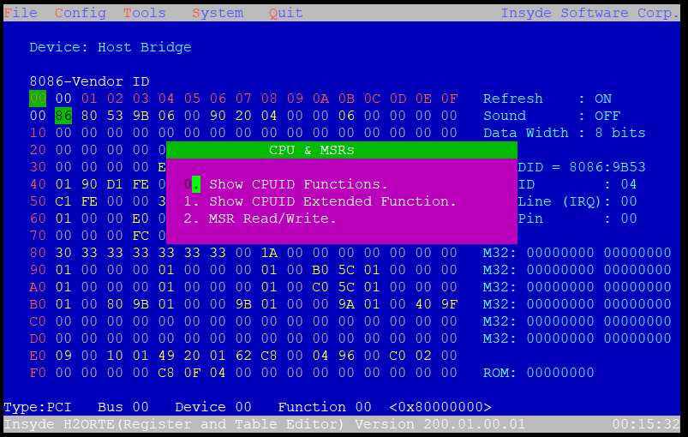
Screenshot of Execution – Config – CPU & MSR

Slide 20
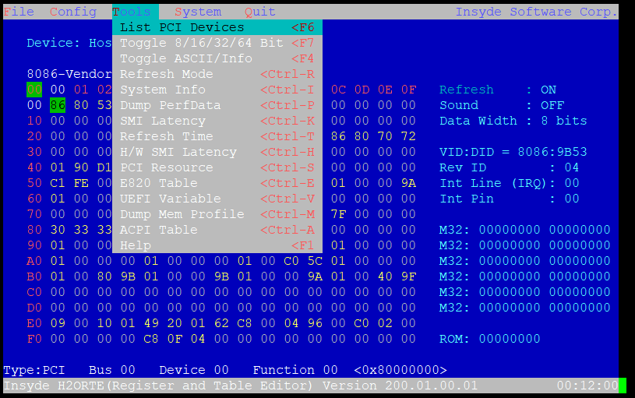
Screenshot of Execution - Tools

Slide 21
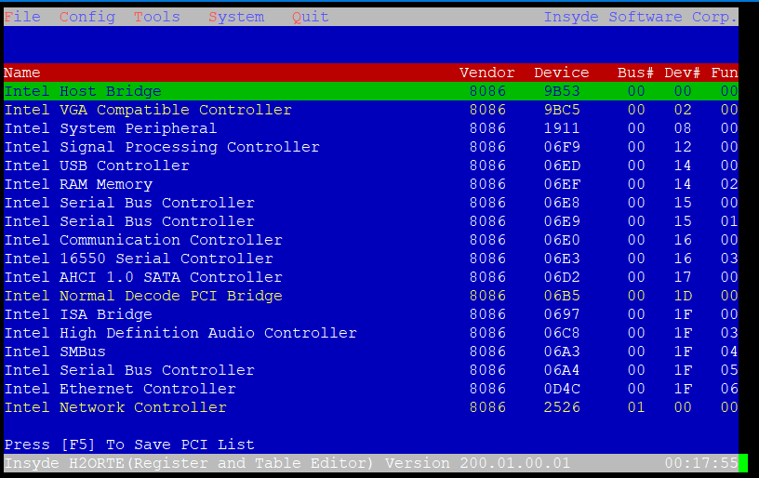
Screenshot of Execution – Tools – List PCI

Slide 22
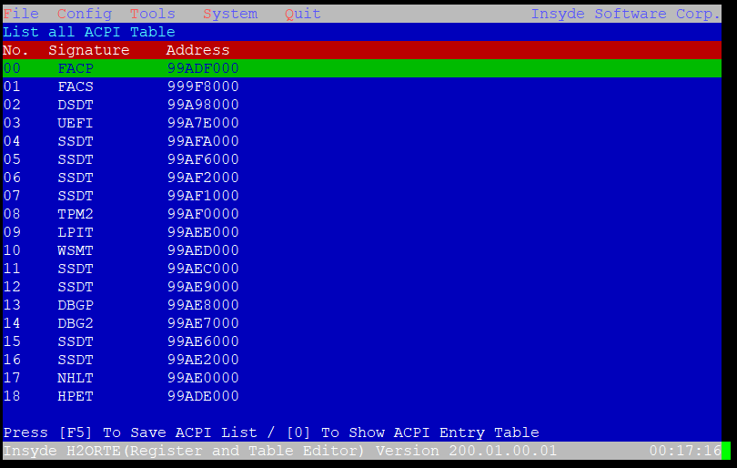
Screenshot of Execution – Tools - ACPI

Slide 23
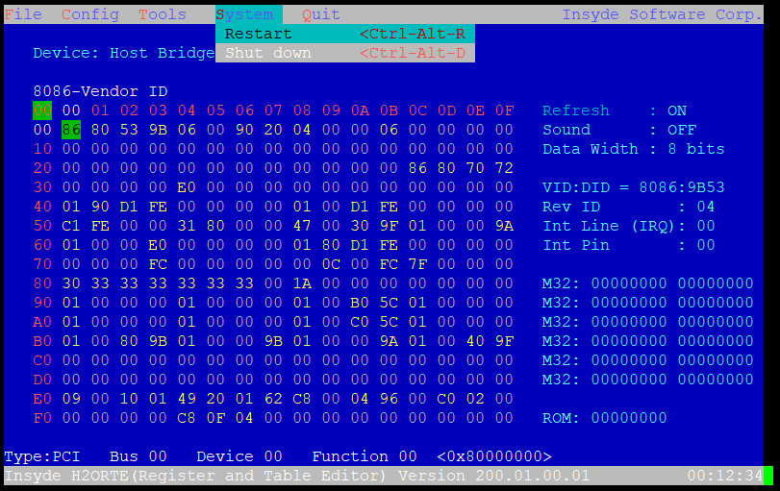
Screenshot of Execution - System

Slide 24
H2OUVE (UEFI Variable Editor)

Slide 25
Features
To provide 4 kinds of UEFI Variable Editors
SCU(Setup) Editor: To edit “runtime/current setup setting” of platform.
Image Setup Editor: To edit “Setup Default Setting” of BIOS image.
Variable Editor: To edit “Variable Data” in runtime ROM or BIOS image.
Multi-Config Editor: To edit “Multi-Config Setting” in runtime ROM or BIOS image.
Supported OS environment
UEFI SHELL
DOS
WINDOWS
LINUX

Slide 26
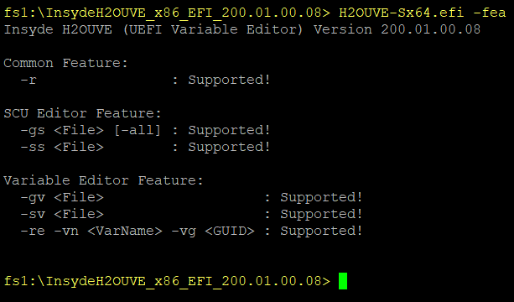
Screenshot of Execution

Slide 27
H2ODST (Diagnostic and System Test)

Slide 28
Features
Testing Mechanisms
One Time Test
Long Run Test
Global Reboot : To do Long Run Test “Full System Reset” of platform
PCI Reset: To do Long Run Test “PCI Reset” of platform
Shut down : To do Long Run Test “Shut down” of platform with Alarm time command(/S).
Supported OS environment
UEFI SHELL

Slide 29
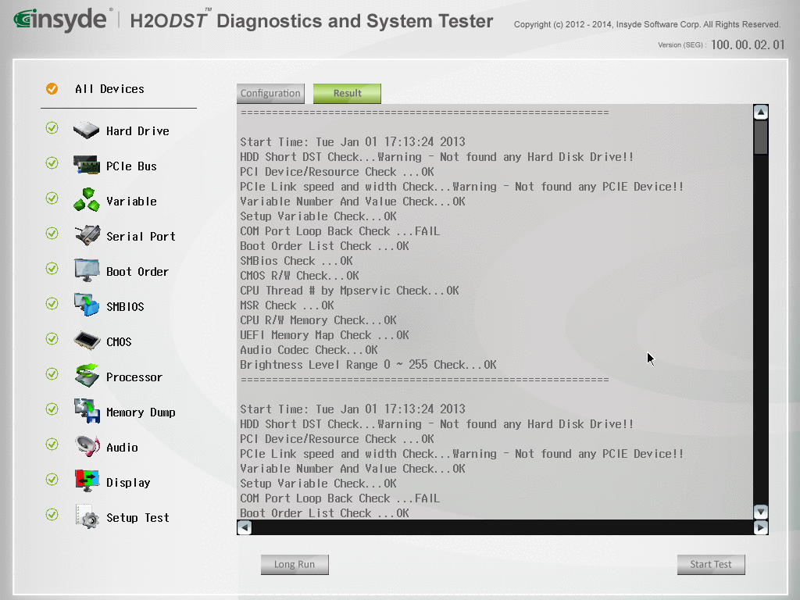
Screenshot of Execution

Slide 30
Thanks!
For more information, contact:
employee@insyde.com

